Slide 1
Electro
R. Shyam
19001177

Slide 2
Introduction
Electro will provide an online ecommerce website
It have various electronic gadgets like watch, phones, laptops and tablet.
It will show reviews.
It have a 2 modules user and admin.

Slide 3
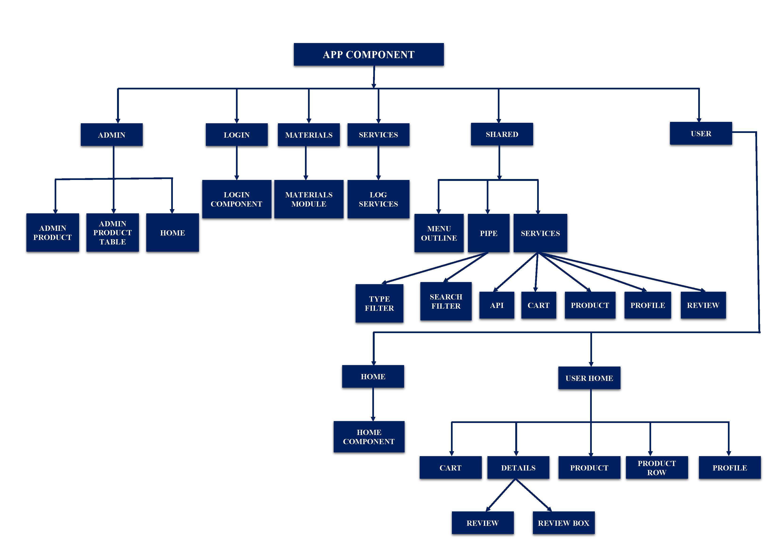
Flowchart

Slide 4
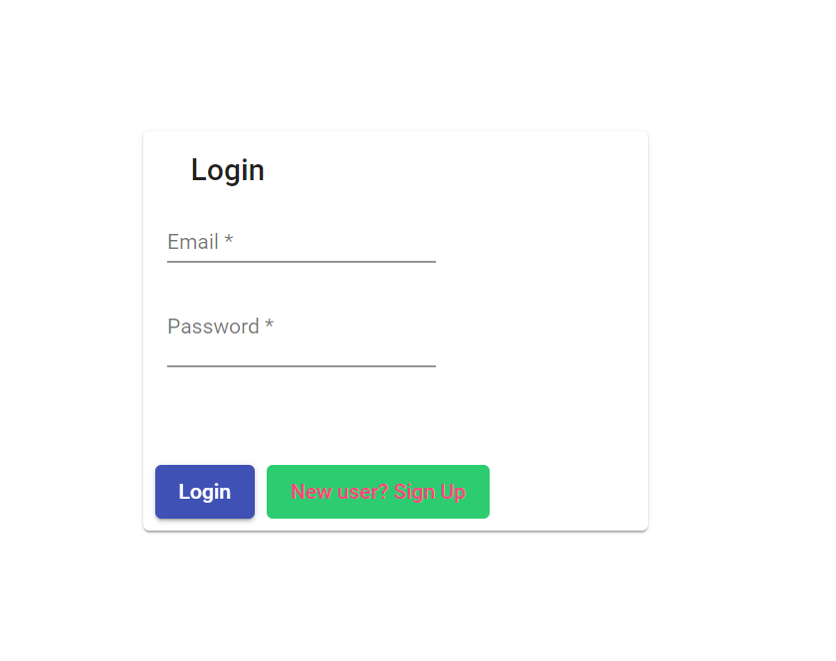
Login Page

Slide 5
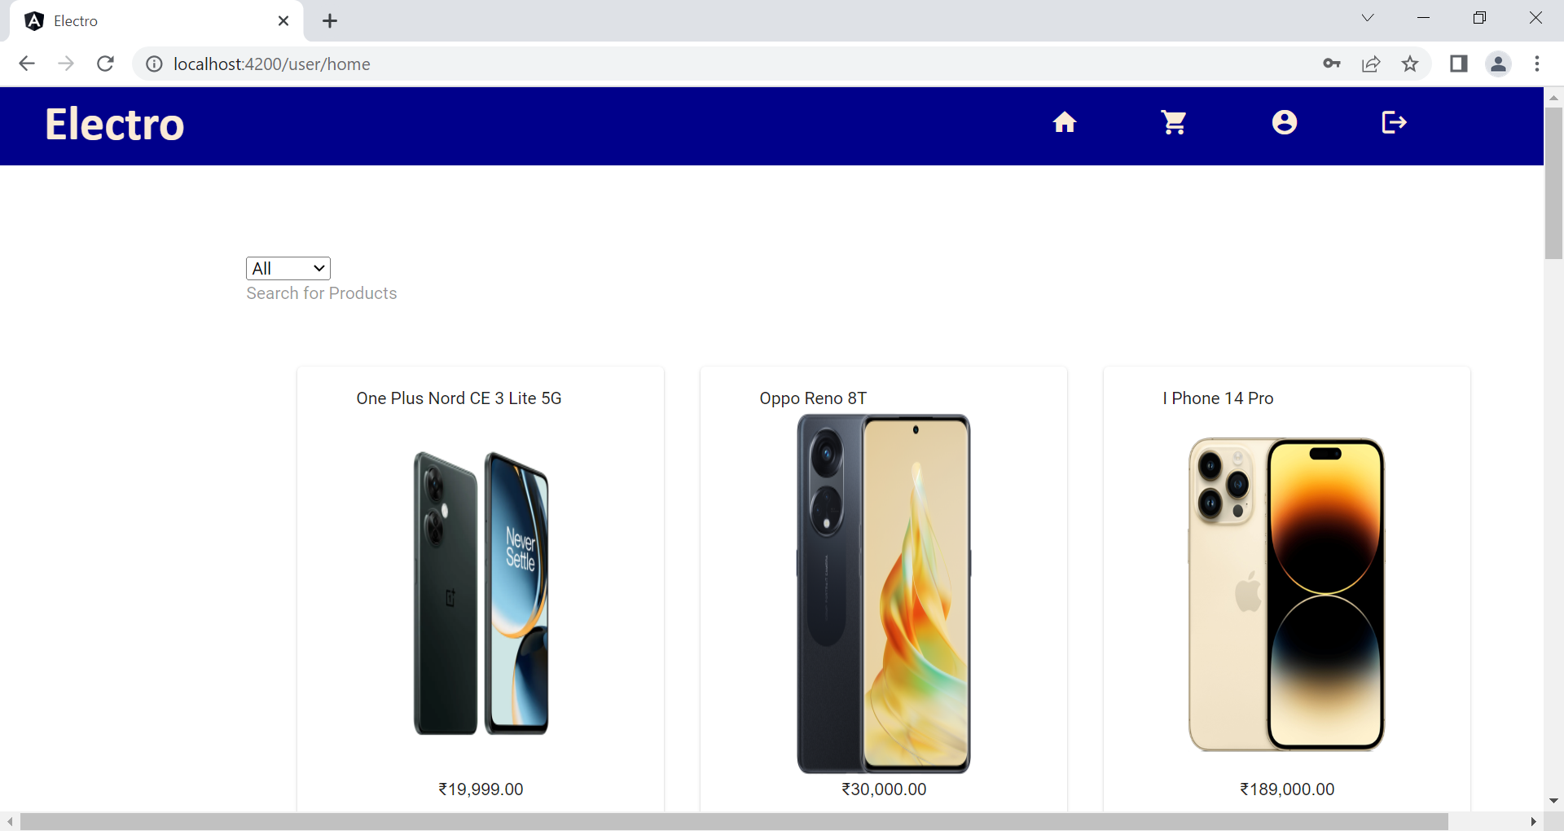
User Home Page

Slide 6
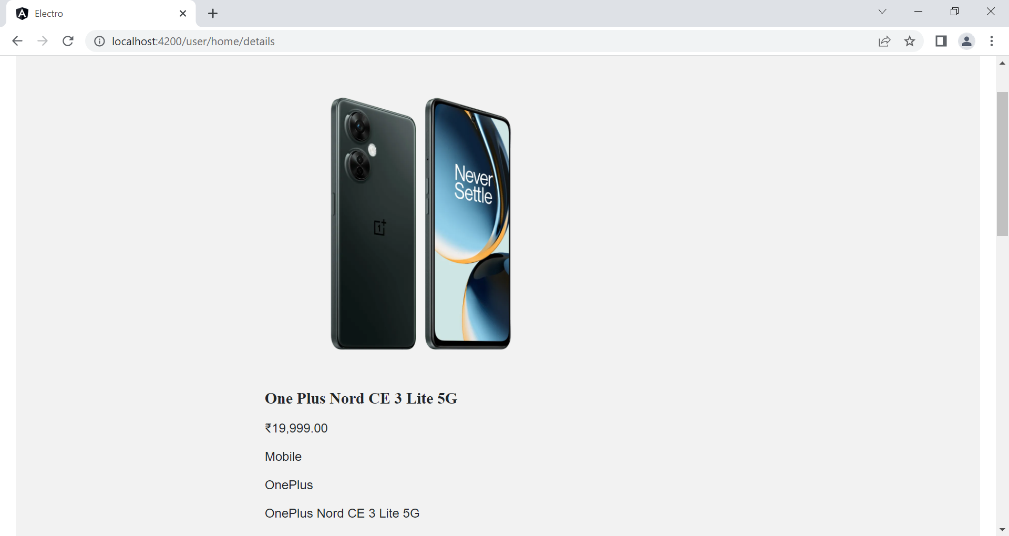
Details

Slide 7
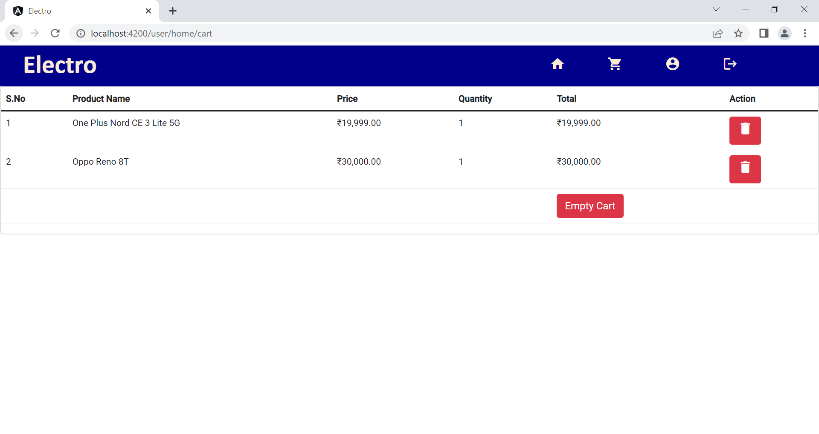
Cart

Slide 8
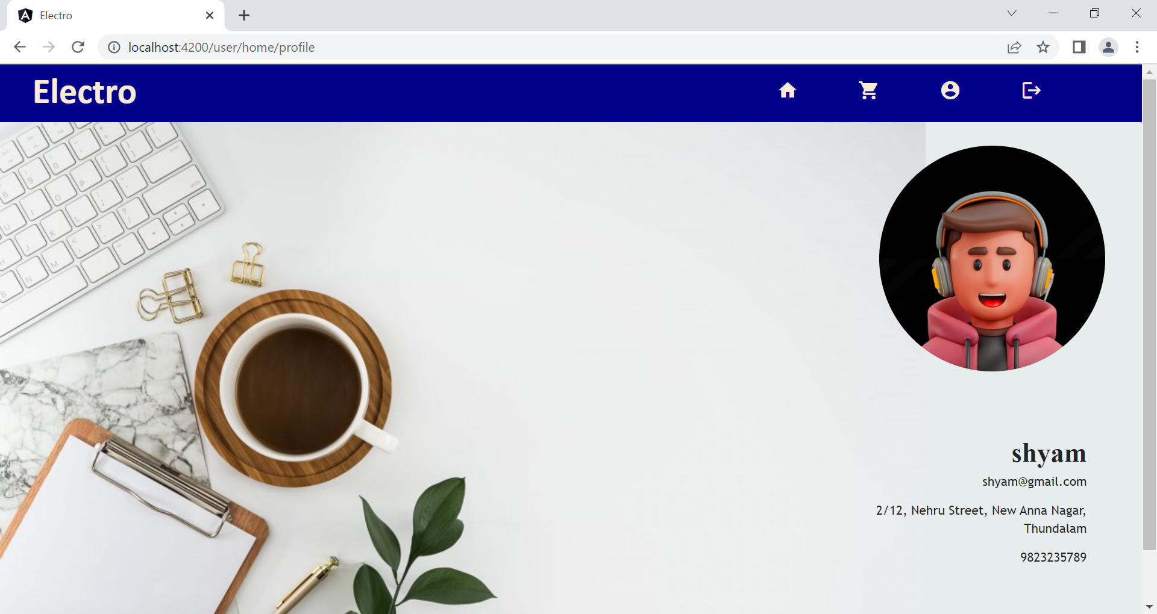
Profile Page

Slide 9
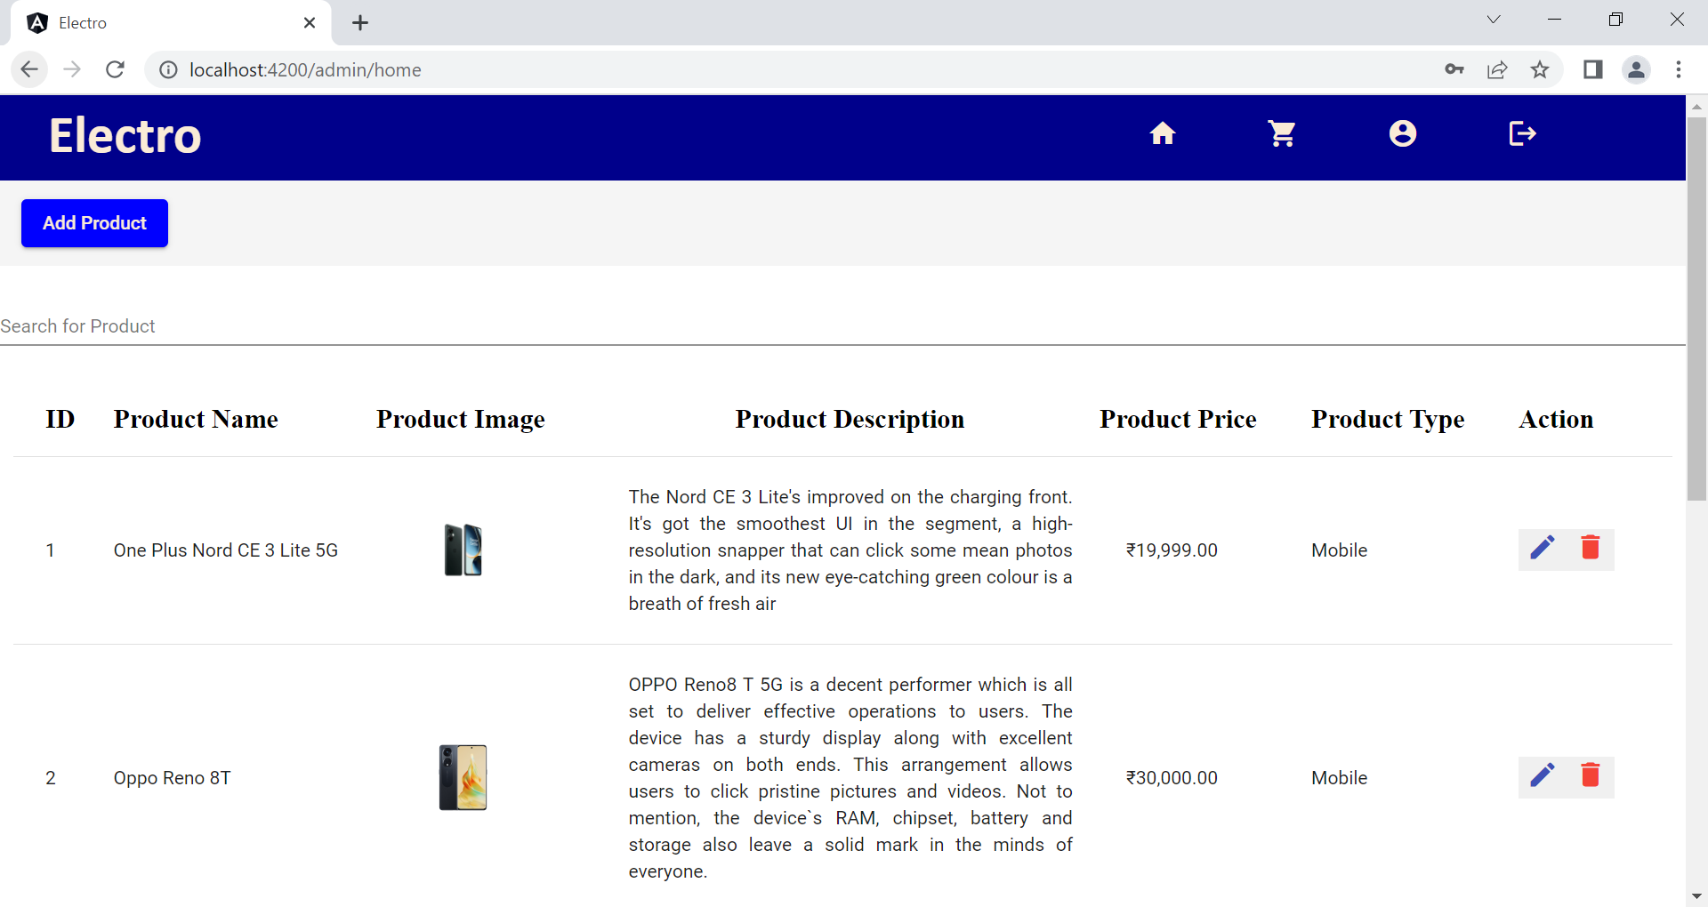
Admin Flow

Slide 10
Thank You

